Slide 1
The Electrical Power Predication of Combined Cycle Power Plant using Regression Model
Presented By: Syeduzzaman Khan

Slide 2
Agenda
Introduction
Objectives
Data set
Simple Linear Regression Model
Multiple Linear Regression Model
Model Comparison
Conclusion and Future Work

Slide 3
Introduction
Combined cycle power plant : gas turbine and steam turbine
Thermodynamical approaches : to need much computational time and effort
Machine learning algorithm: an alternative solution, to analyze this system for arbitrary input ad output patterns
Gas turbine: Ambient temperature, pressure, and relative humidity
Stem turbine: direct relationship with vacuum of exhaust

Slide 4
Objectives
Predicting electrical power output of a power plant
To increase the power plant efficiency
Profit maximization
Machine learning method : Linear regression method

Slide 5
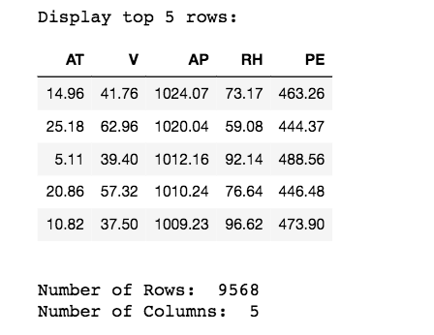
Data set and Response Variable
Input Factors:
Ambient Temperature (AT)
Relative Humidity (RH)
Ambient Pressure (AP)
Exhaust Vacuum (V)
Response Variable:
Electrical Power (PE)

Slide 6
Correlation
The highest correlation among input features is between T and V (0.84).
The highest correlations with target variable are also observed with T (- 0.95) and V(-0.87).

Slide 7
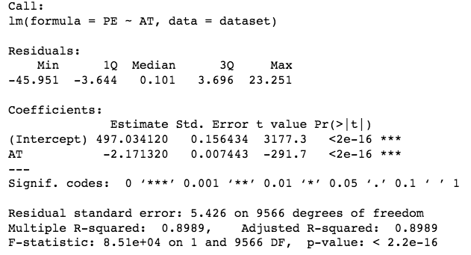
Simple Linear Regression Model
Based on Temperature
Adjusted R-squared 0.8989
PE= -2.17*AT+497.03

Slide 8
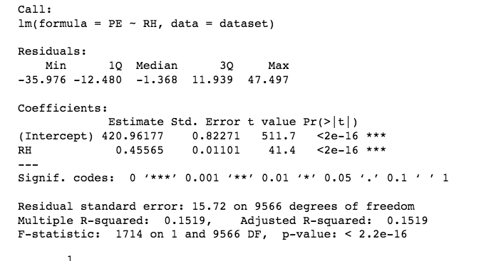
Simple Linear Regression Model (Contd.)
Based on Humidity
Adjusted R-squared 0.1519
PE= 0.46*RH+420.96

Slide 9
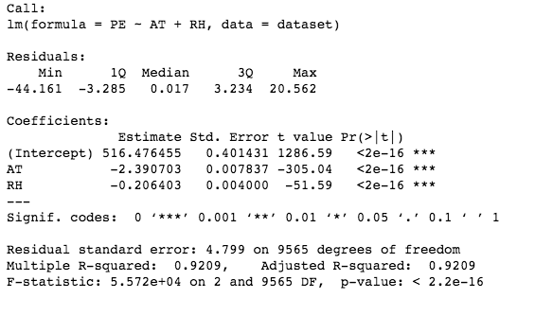
Multiple Linear Regression Model
Combination of Temperature and Humidity
Adjusted R-squared 0.9209
PE= -2.39*AT-0.206*RH+516.47

Slide 10
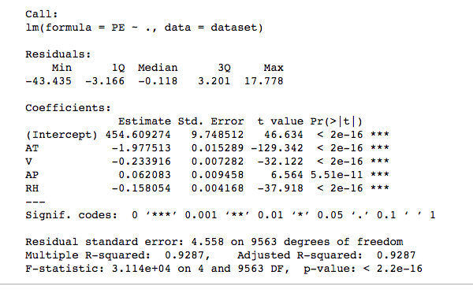
Multiple Linear Regression Model (Contd.)
By combining all variables:
R squared value 0.9287
PE= -1.97*AT-0.23*V+0.62*AP-0.16*RH+454.61

Slide 11
SLR VS. MLR Model
Simple linear regression: model based on temperature has higher R-squared value (0.8989)
MLR Model: R squared value highest (0.9287) by combining all variables

Slide 12
Conclusion and Future Works
Summary:
To investigate efficient Predictive model for Combined cycle power plant to predict electrical power to be generated
To find out most influent individual variables or combination of variables
Future Possibilities :
K-nearest neighbor, ANN (Artificial neural network)
Model comparison

Slide 13
Questions ???

